Slide 1

AE monetary & fiscal policies & trade wars: implications for EMs
E6XYB6412478
April 30, 2018
Willem Buiter^{AC}
Special Economic Adviser
willem.buiter@citi.com
+1 212-816-2363
See Appendix A-1 for Analyst Certification, Important Disclosures and non-US research analyst disclosures
Citi Research is a division of Citigroup Global Markets Inc. (the "Firm"), which does and seeks to do business with companies covered in its research reports. As a result, investors should be aware that the Firm may have a conflict of interest that could affect the objectivity of this report. Investors should consider this report as only a single factor in making their investment decision. Certain products (not inconsistent with the author's published research) are available only on Citi's portals.
This presentation was approved for distribution on 30 April 2018; the disclosures in Appendix A1 are current as of the same date.

Slide 2
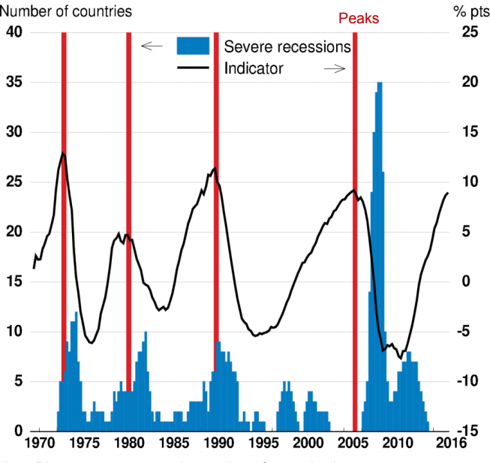
Global Economic Outlook: As Good As It Gets
Global real GDP growth remains broad-based and we continue to expect robust, above-consensus growth (3.4%YY in 2018 and 2019, at market exchange rates).
Global Nowcast Of Growth and Manufacturing PMI
House Price Booms And Recessions
Note: Global Manufacturing PMI using ISM for the US
Source: Markit, Now-Casting Economics and Citi Research
Note: Blue areas represent the number of countries in a severe recession. The global real house price index is constructed as a GDP-weighted average across OECD countries and is measured as deviation from trend.
Source: Hermansen and Röhn (2017)
Notes:
H:\Global Economics\Global Forecast Related\Global Overviews_GDP_Quarterly since 1980.xlsx
H:\Global Economics\Global - AE\Global Industrial Production.xlsx
H:\Global Economics\GEOS\2017\GEOS Prospects for 2018\Investment\Aggregate Global investment breakdown.xlsx
H:\Global Economics\Nowcasting\Haver Nowcasting.xlsx

Slide 3
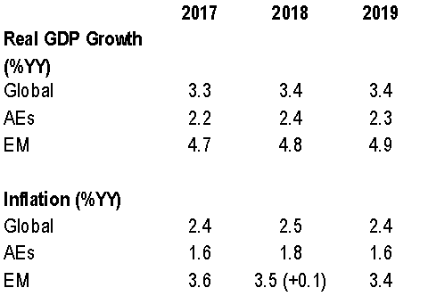
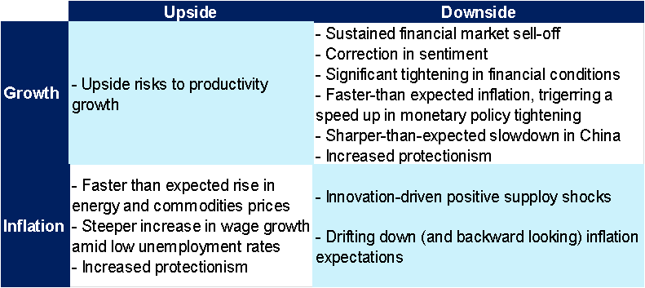
2018: Strong Growth, Steady Inflation, Tightening Monetary Policy
We continue to expect robust, above-consensus global growth (3.4%YY in 2018 and 2019, at market exchange rates), slowly rising global and AE inflation, and moderate AE monetary tightening.
Global growth continues to be robust and broad-based, driven by industrial activity and investment. However, signs of a slowdown are emerging.
Advanced economy inflation is slowly rising, but remains subdued despite robust growth and tight labor markets.
Monetary policy is tightening: 6 out of 10 AE central banks to raise policy rates in 2018 (75bp for Fed and BoC, 25bp for others). Central bank net asset purchases to fall to roughly zero by year-end.
Economic Forecasts
Note: Numbers in brackets are revisions from previous month forecasts
Advanced Economy Policy Rates Forecasts
Balance of Risks
 | Current Policy Rate | End-2018
 |  | Citi | Priced in OIS curve as of
 |  | Forecast | Apr-18 | Mar-18 | Dec-16
AE | 0.72 | 0.99 | 1.03 | 1.07 | 0.80
US | 1.625 | 2.125 | 2.16 | 2.23 | 1.66
Euro area | -0.40 | -0.40 | -0.38 | -0.38 | -0.32
Japan | -0.10 | -0.10 | -0.04 | -0.01 | -0.05
UK | 0.50 | 0.75 | 0.94 | 0.94 | 0.55
Canada | 1.25 | 1.75 | 1.82 | 1.80 | 1.07
Australia | 1.50 | 1.75 | 1.63 | 1.66 | 2.12
Norway | 0.50 | 0.75 | - | - | -
NZ | 1.75 | 1.75 | 1.87 | 1.89 | 2.88
Sweden | -0.50 | -0.25 | -0.59 | -0.42 | 0.06
Switzerland | -0.75 | -0.75 | - | - | -
Note: As of April 17, 2018. Aggregate without Norway and Switzerland.
Note: As of 18 April 2018. Aggregates at market exchange rates. Inflation aggregate with US PCE, CPI for the rest.
See: Global Economic Outlook and Strategy: April 2018 Source: National Statistical Offices and Citi Research
Notes:
GEOS (Updated)
What is priced in
*Capitalized major words of the title of the slide

Slide 4
As Good As It Gets
 | Global Growth: Still Strong, But No Longer Strengthening
 | Are We Running Out Of Room in This Cycle?
 | Monetary Policy Normalization Why is The Dollar Weakening? Are we heading for a Trade War? How resilient is India to likely shocks?

Slide 5
The Global Economy Looks Pretty Good
We expect global real GDP growth to take a breather and moderate in Q1 to 3.3%YY (-0.1pp from last month’s estimate) and 2.9%SAAR (-0.2pp) but to rebound in Q2. Growth remains broad-based.
Global Nowcast Of Growth and Manufacturing PMI
Near-term Real GDP Forecasts Remain Unchanged
Note: Global Manufacturing PMI using ISM for the US
Source: Markit, Now-Casting Economics and Citi Research
Note: Global aggregate at market exchange rates
Source: Citi Research
Notes:
H:\Global Economics\Global Forecast Related\Global Overviews_GDP_Quarterly since 1980.xlsx
H:\Global Economics\Global - AE\Global Industrial Production.xlsx
H:\Global Economics\GEOS\2017\GEOS Prospects for 2018\Investment\Aggregate Global investment breakdown.xlsx
H:\Global Economics\Nowcasting\Haver Nowcasting.xlsx

Slide 6
The Global Economy Still Looks Pretty Good
Global growth continues to be supported by ongoing strength in activity and sentiment indicators. Global investment growth is robust (highest since Q1-14) and AE unemployment is at the lowest level since 1990.
Real Gross Fixed Investment (%YY)
Countries in Recession
Note: Aggregates at market exchange rates. Source: National Statistical Offices, IMF and Citi Research
Source: National Statistical Offices, IMF and Citi Research
Unemployment (%)
Business and Consumer Confidence
Source: National Statistical Offices and Citi Research
Source: Markit, Now-Casting Economics and Citi Research
Notes:
H:\Global Economics\Global Forecast Related\Global Overviews_GDP_Quarterly since 1980.xlsx
H:\Global Economics\Global - AE\Global Industrial Production.xlsx
H:\Global Economics\GEOS\2017\GEOS Prospects for 2018\Investment\Aggregate Global investment breakdown.xlsx
H:\Global Economics\Nowcasting\Haver Nowcasting.xlsx

Slide 7
US: Growth Has Picking Up and is Broad-Based
US Growth is Picking Up and Broadening Ahead of Stimulus
US Sentiment Indicators are Picking Up
Source: Haver Analytics and Citi Research
Source: ISM and Citi Research

Slide 8
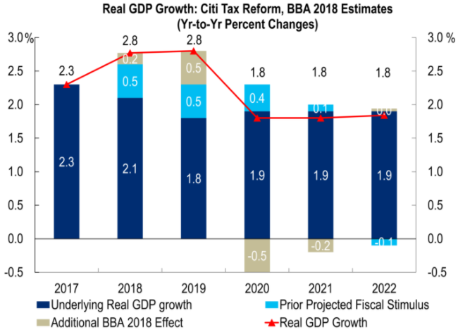
US: Fiscal Stimulus Likely Boost Growth in 2018 and 2019
Note: Stimulus includes tax reform, defense spending, infrastructure. BBA 2018 is Bipartisan Budget Act. Source: Citi Research

Slide 9
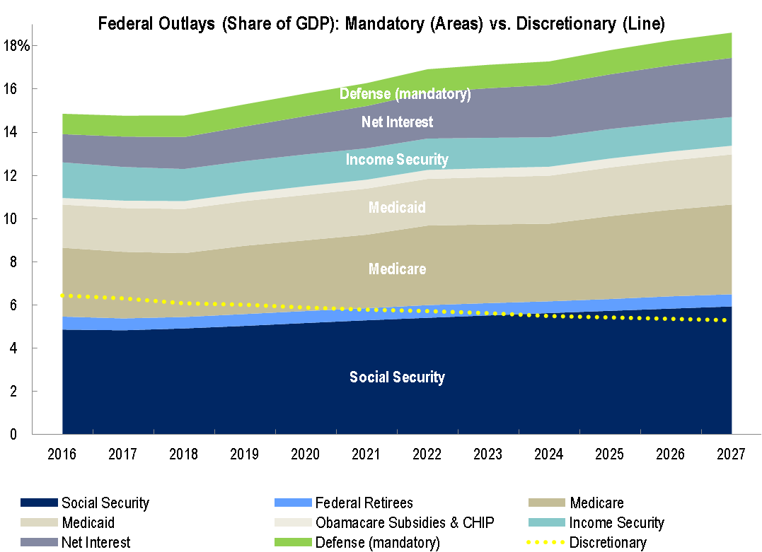
But A Fiscal Hangover In the US Looms Eventually
US - Fiscal Deficit (% of GDP) and Unemployment Rate (%)
Mandatory Outlays are Poised to Expand Budget Deficits While Discretionary Outlays Continue to Shrink
Source: OECD, BLS, and Citi Research

Slide 10
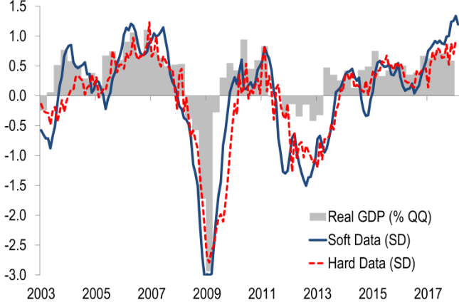
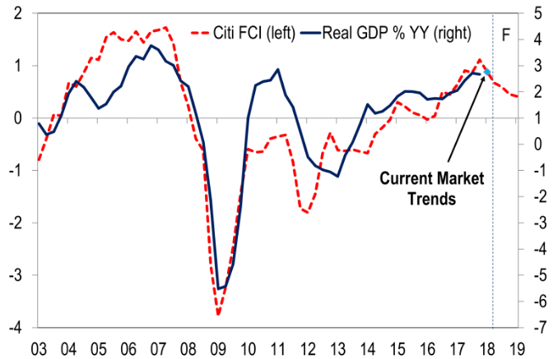
Eurozone: Peak Momentum Has Passed
Surveys have run ahead of growth rates so far, but may be topping out now. Even then, sentiment and financial conditions are still consistent with our baseline of real GDP growth around 2.4% in the next three quarters.
Euro Area – Selected Survey and Hard Data, Real GDP Growth, Jan-03-Feb-18
Euro Area – Real M1 and Real GDP, Annual Growth Rates, 1Q-99-1Q-18
Note: Soft data include ESI, composite PMI, Eurocoin and Sentix expectations. Hard data include the YY growth rates of IP, manufacturing new orders, construction output, retail sales, car registrations, exports and joblessness. Source: European Commission, Eurostat, Haver Analytics and Citi Research
Note: FCI is financial conditions index.
Source: European Central Bank and Citi Research

Slide 11
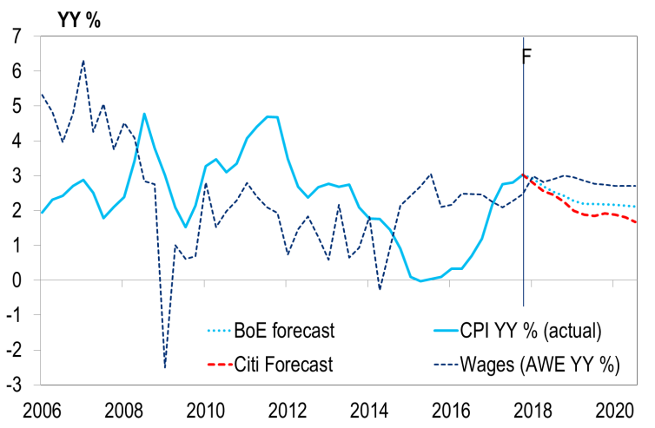
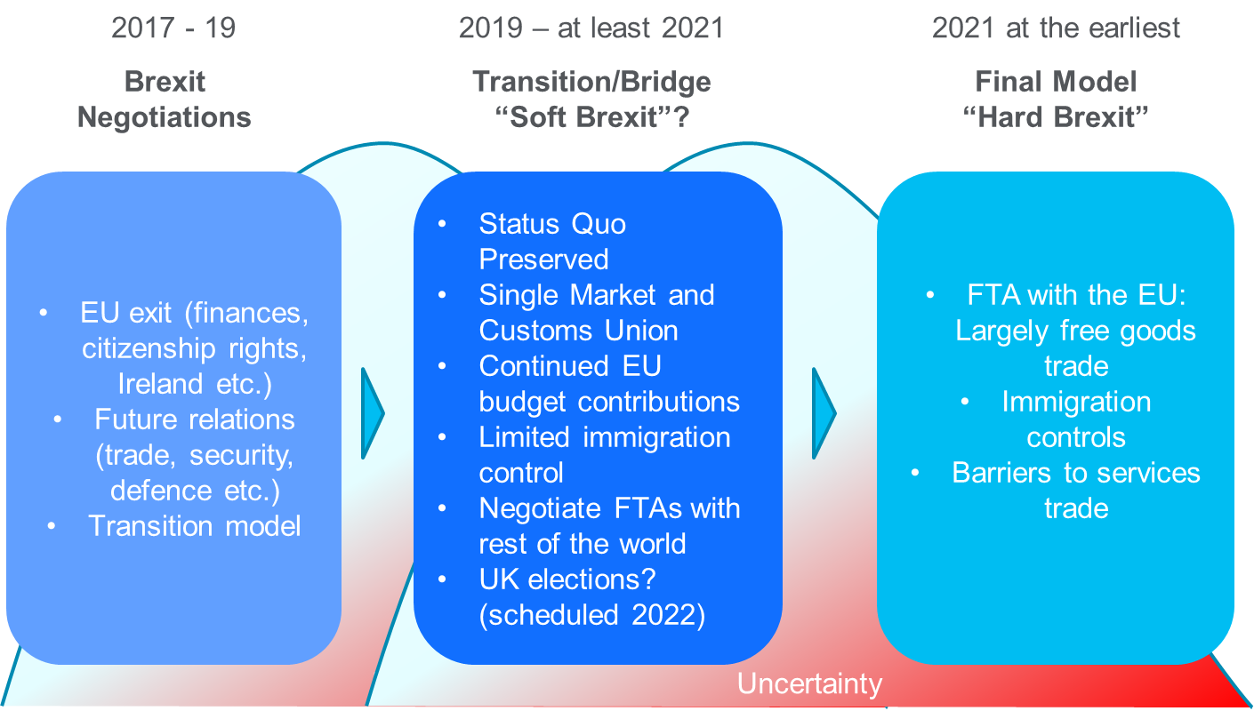
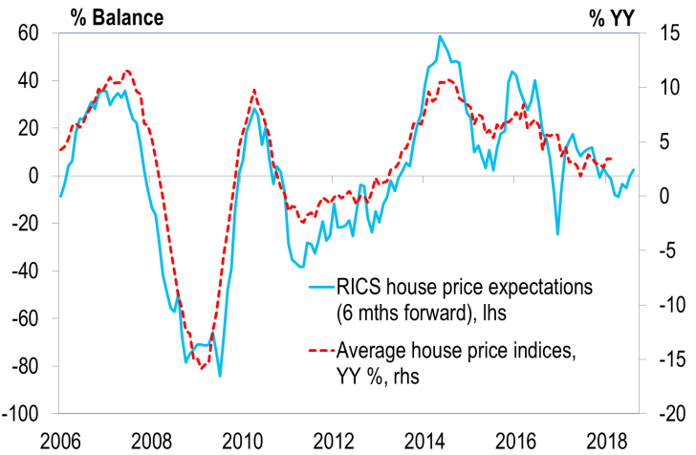
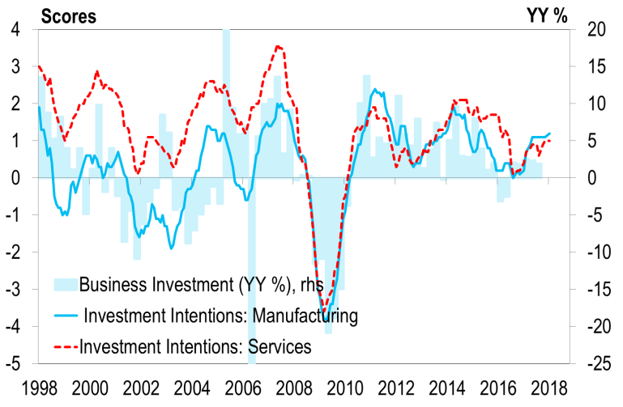
UK: Consumers in Focus as Major Risks Still Lie Ahead
With inflation slowing and wages rising, the real wage squeeze should fade. House prices are stabilising, but investment remains subdued as Brexit rumbles on. Nothing is agreed until everything is agreed.
UK- Earnings, CPI Inflation (YY %)
YY %, 2006-2020F
UK Brexit Process (Citi base case)
YY %, 1997-2025
UK- RICS House Price Exp. and Prices
(%-Balance, YY %), 2006-2018
UK- Investment Intentions and Investment
(Score, %YY), 1998-2017
Source: BoE, Markit, ONS, Lloyds, CBI, GfK, Royal Institution of Chartered Surveyors (RICS), Halifax, Nationwide and Citi Research

Slide 12
Japan: Growth is There, Inflation Continues to Lag
GDP Growth, Inflation, Real GDP
Exchange Rate vs BOJ
Source: National Statistical Offices and Citi Research
Source: Markit, ISM and Citi Research

Slide 13
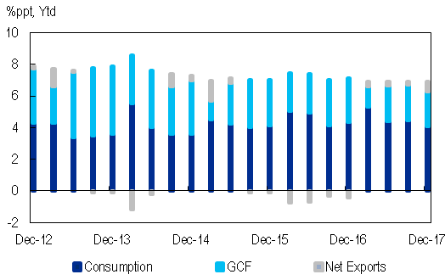
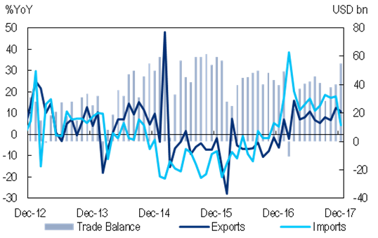
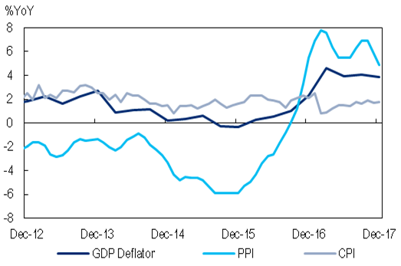
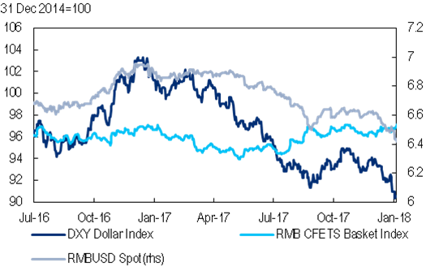
China: 2017 Growth Outperformed. We see steady growth in ‘18
“High in H1 and low in H2”, China’s official overall GDP growth in 2017 defied the pessimistic market expectation at the start of the year. But 2018 may be more difficult, as policy stimulus fades.
Consumption is the Main Contributor to GDP Growth
Exports Remained Strong
Source: CEIC and Citi Research
Source: CEIC and Citi Research
GDP Deflator Slowed
RMB Surprisingly Appreciated
Source: CEIC and Citi Research
Source: CEIC and Citi Research

Slide 14
Global: Q1 Softness Is Probably an Aberration
Recent data have supported the idea that global growth may be peaking, with modestly higher downside risks than before. However, we think there is no major cause for concern about a cyclical downturn yet.
Global, AE, EM – Real GDP Growth (%QQ saar), 2010-2017
US – Q1 GDP Growth Nowcast (%QQ saar), 2018
Note: Aggregates at market exchange rates. Source: National Statistical Offices, IMF and Citi Research
Source: FRB Atlanta, FRB NY and Citi Research
Global Credit Impulse
Copper Prices have Softened Recently
Note: The credit impulse is the 12m change in the 12m sum of monthly credit flows as a % of GDP. Global credit impulse accounts for roughly 90% of global GDP. Source: National Statistical Offices and Citi Research, See: Global Economics View - Will China’s credit impulse cut the global recovery short?
Source: Bloomberg and Citi Research
Notes:
H:\Global Economics\Global Forecast Related\Global Overviews_GDP_Quarterly since 1980.xlsx
H:\Global Economics\Global - AE\Global Industrial Production.xlsx
H:\Global Economics\GEOS\2017\GEOS Prospects for 2018\Investment\Aggregate Global investment breakdown.xlsx
H:\Global Presentations\2018\March\Copper prices.xlsx

Slide 15
As Good As It Gets
 | Global Growth: Still Strong, But No Longer Strengthening
 | Are We Running Out Of Room in This Cycle?
 | Monetary Policy Normalization Why is The Dollar Weakening? Are we heading for a Trade War? How resilient is India to likely shocks?

Slide 16
The World Is Still Cyclical
Business cycles are increasingly mature, in the US more than elsewhere. Resilience to shocks is falling over time, as i) slack is low, ii) pent-up demand is moderating and iii) financial vulnerabilities are rising.
Length of Current US Expansion in Historical Perspective – since 1854
Source: National Statistical Offices and Citi Research.
Notes:
H:\Global Economics\Global - Prices\Global - US\Duration of current expansion.xlsx

Slide 17
Business Cycle Arithmetic: This Cycle is Long, but Not Strong
Current US expansion is only 14th longest out of 46 expansions across AEs since 1980. Size of expansion is smaller than for historical average, in US and many other AEs.
Duration Of Expansion In Real GDP
Growth Gap Vs Average Cycle (pp), 1980-2017
Note: Trough defined according to NBER methodology. Numbers in parenthesis refer to the number of expansions previous to the current one since 1980.
Source: National Statistical Offices and Citi Research
Note: Difference in cumulative growth in current cycle vs average. Cycle is defined as trough to peak.
Source: National Statistical Offices and Citi Research

Slide 18
Labor Markets are Fairly Tight and Getting Tighter
Labor market slack is now low across AEs, according to most measures. There are increasing signs of labor shortages – except in wage inflation or unit labor costs.
US Unemployment Rate
Labor Shortages (SD around Mean),
1993-3Q 17
Source: Federal Reserve, University of Michigan, Bloomberg and Citi Research
Note: NFIB “Businesses with few or no qualified applicants for job openings”; Tankan “Employment conditions”; EU Commission “Labor as factor limiting production”. Source: Haver Analytics and Citi Research
Notes:
H:\Global Economics\Presentations\2017\October 2017\Why is inflation so low\U-3 U-6 US Unemployment rate.xlsx
H:\Global Economics\Presentations\2017\October 2017\Why is inflation so low\Capacity utilization.xlsx

Slide 19
Wage Growth and Inflation Still Low
We expect relatively steady AE inflation at 1.8% (+0.1pp from last month’s forecast) in 2018 and 1.6% in 2019. AE inflation is slowly rising but inflation and wage pressure remain subdued.
Headline CPI Inflation (%YY)
US Core CPI Inflation, ECI and Average Hourly Earnings (%YY), 2013-2018
Source: National Statistical Offices and Citi Research
Source: BLS and Citi Research

Slide 20
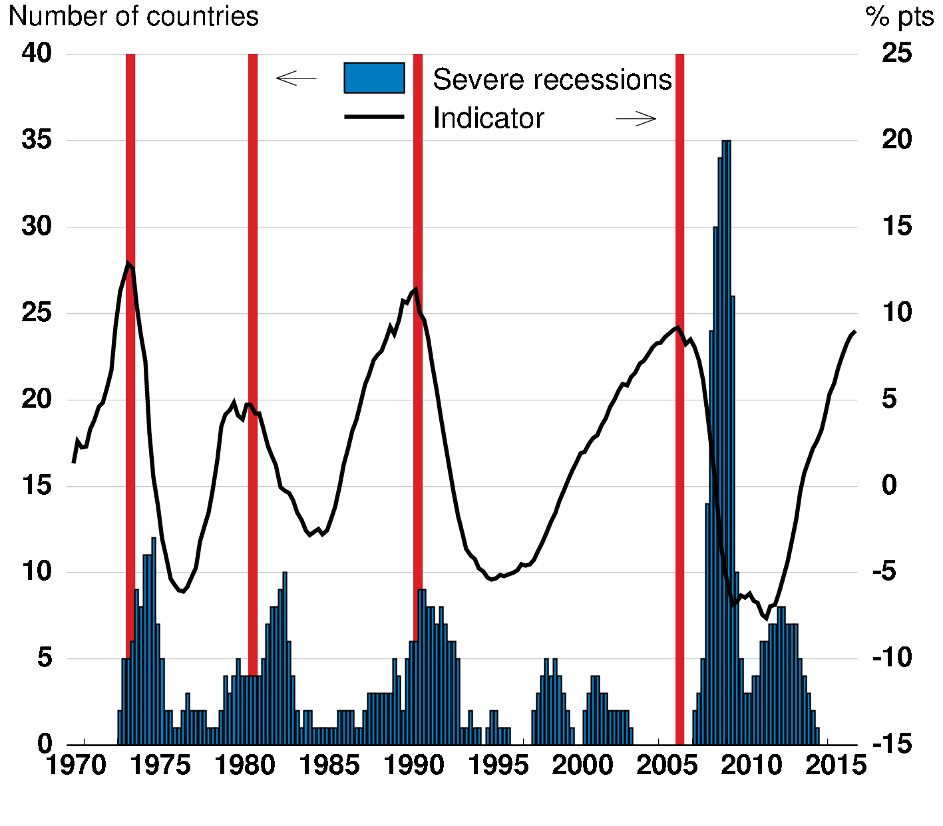
But Some Cracks Are Appearing: Asset Valuations Are Stretched and are beginning to nudge down for equities
Equity Valuations are High
Global Real House Price Index
Source: Robert Shiller and Citi Research
Note: Blue areas represent the number of countries in a severe recession. The global real house price index is constructed as a GDP-weighted average across OECD countries and is measured as deviation from trend. Source: Hermansen and Röhn (2017)

Slide 21
As Good As It Gets
 | Global Growth: Still Strong, But No Longer Strengthening
 | Are We Running Out Of Room in This Cycle?
 | Monetary Policy Normalization Why is The Dollar Weakening? Are we heading for a Trade War? How resilient is India to likely shocks?

Slide 22
Monetary Policy Is Tightening Across AEs
We expect seven out of 10 AE central banks to hike rates in 2018 (Fed: +75bp, BoC: +75bp), raising the average AE policy rate to 1% by end-2018 (highest rate since 2008, largest increase since 2006).
Policy Rate Forecasts and OIS Pricing
AE Policy Rates
 | Current Policy Rate | End-2018 |  |  |  | End-2019
 |  | Citi | Priced in OIS curve as of |  |  | Citi | Priced in OIS curve as of
 |  | Forecast | Apr-18 | Mar-18 | Dec-16 | Forecast | Apr-18 | Mar-18 | Dec-16
AE | 0.72 | 0.99 | 1.03 | 1.07 | 0.80 | 1.51 | 1.47 | 1.36 | 1.01
US | 1.625 | 2.125 | 2.16 | 2.23 | 1.66 | 2.88 | 2.79 | 2.44 | 1.92
Euro area | -0.40 | -0.40 | -0.38 | -0.38 | -0.32 | 0.00 | -0.06 | 0.09 | -0.13
Japan | -0.10 | -0.10 | -0.04 | -0.01 | -0.05 | -0.10 | 0.01 | 0.00 | -0.03
UK | 0.50 | 0.75 | 0.94 | 0.94 | 0.55 | 1.00 | 1.18 | 1.20 | 0.75
Canada | 1.25 | 1.75 | 1.82 | 1.81 | 1.07 | 2.50 | 2.19 | 2.21 | 1.31
Australia | 1.50 | 1.75 | 1.63 | 1.66 | 2.12 | 2.25 | 2.11 | 2.16 | 2.44
NZ | 0.50 | 0.75 | - | - | - | 1.25 | - | - | -
Sweden | 1.75 | 1.75 | 1.87 | 1.89 | 2.88 | 2.25 | 2.31 | 2.39 | 3.24
Source: National Central Banks and Citi Research
Note: Apr-18 is 16 April, 2018; Mar-18 is 20 March, 2018; Dec-16 is 28 December, 2016. OIS aggregate without Norway and Switzerland. Sources: Bloomberg, National Central Banks and Citi Research
22
Notes:
Geos (updated)
H:\Global Economics\GEOS\2017\GEOS October 2017\What is priced in OIS.xlsx
H:\Global Economics\Global - Financial\Nominal and Real Rates in AE.xlsx

Slide 23
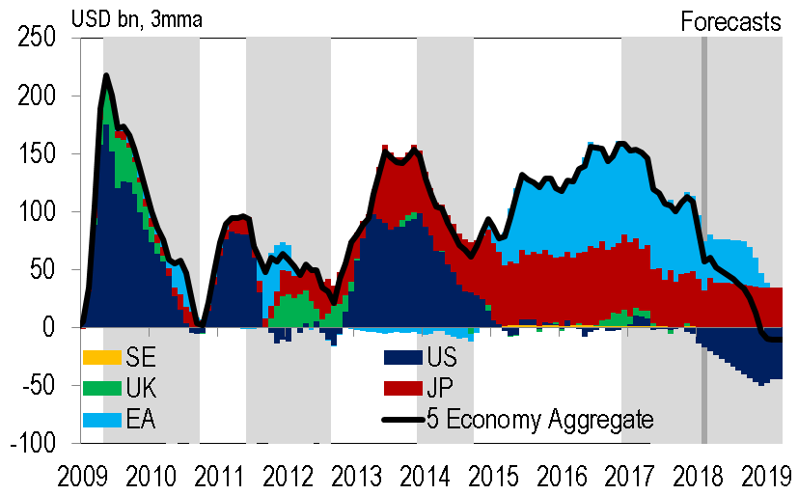
Global Tapering Will Boost Net Supply of Government Bonds
Net supply of relevant assets is rising by roughly $2trn by end-2019. We think the direct effect of global tapering on the real economy is limited, but major asset market corrections could trigger or cause a global slowdown.
Central Bank Net Asset Purchases are Tumbling
Securities Net Net Supply
Source: National Central Banks and Citi Research
Note: net net supply is net supply after deducting central bank net purchases. ‘Other’ includes Eurozone corporate and covered bonds, and UK Gilts.
Source: National Central banks and Citi Research
Notes:
H:\Global Economics\Global - Monetary Policy\Central Bank Balance Sheets\Balance sheets CR_ER - corrected.xlsx

Slide 24
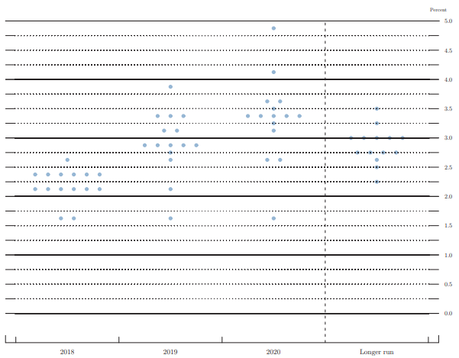
US – Market Has Been Moving Toward Dots
Market Pricing
Median
Source: Citi Research, Federal Reserve

Slide 25
US – Financial Conditions have begun to tighten
Financial conditions tightened recently, and particularly those adjusted for economic conditions.
US – National Financial Conditions Index
(std dev)
Source: Chicago Fed and Citi Research

Slide 26
As Good As It Gets
 | Global Growth: Still Strong, But No Longer Strengthening
 | Are We Running Out Of Room in This Cycle?
 | Monetary Policy Normalization Why is The Dollar Weakening? Are we heading for a Trade War? How resilient is India to likely shocks?

Slide 27
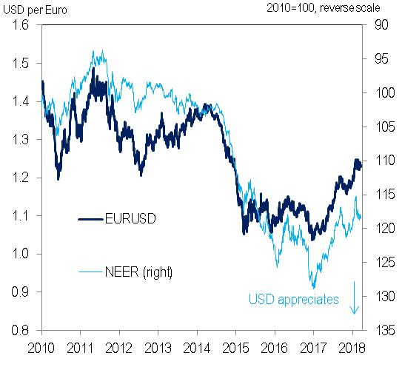
Why Is the USD Weakening? So many explanations…
Growth: Relative growth in the rest of the world has been catching up with the US
Monetary policy: stronger (smaller) economies in RoW may call for tighter policy there too, but less so than the US (e.g. UK, Norway)
→ both may have pushed down USD and relative term spreads across US and Eurozone
Inflation? US late-cycle fiscal expansion could push up relative inflation (should strengthen the currency – correlation ≠ causation)
US external deficits: may require lower real exchange rate to balance (who or what enforces these “requirements”?)
Valuations: USD was relatively strong at the beginning of Fed’s hiking cycle
Short-term Positioning: (SOME!) Investors have moved from net short EUR to net short USD (and the world is running a trade deficit … )
Long-term positioning: foreigners own a lot of dollar assets (but the US has positive net foreign investment income)
Source: Citi Research
Notes:
From the geos calendar, just bullets
-The S&P has gained approximately 15% this year
*Capitalized major words in the title

Slide 28
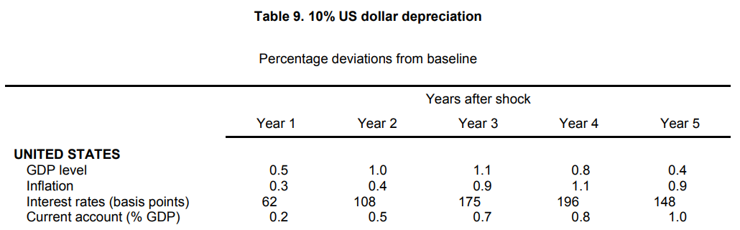
USD Appreciation Could Affect the US And the Global Economy
Hyun Song Shin, BIS Economic Advisor and Head of Research: “It is not just the impact of a stronger dollar on the US. The global economy will be affected, as the dollar is now a variable that reflects global risk appetite.”
The OECD Estimates that ~10% USD Appreciation Would Lower GDP by 0.5% After One Year
Note, the results for a 10% currency depreciation are arithmetically equivalent to those for an 11.1% currency appreciation but with the opposite sign. Source: OECD
28

Slide 29
As Good As It Gets
 | Global Growth: Still Strong, But No Longer Strengthening
 | Are We Running Out Of Room in This Cycle?
 | Monetary Policy Normalization Why is The Dollar Weakening? Are we heading for a Trade War? How resilient is India to likely shocks?

Slide 30
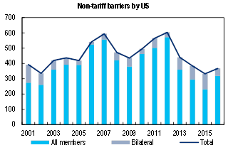
Protectionism Appears to be Rising
Particularly for non-tariff barriers, including local content rules, rules of origin, licensing and (labor, environmental, health and safety, etc.) standards requirements. US actions also threaten the workings of the WTO.
Global – Number of New Trade Measures Implemented,
2009-2017
Select Economies – Number of New Harmful Trade Measures Implemented, 2009-2017
Note: All new measures taken each year. Source: Global Trade Alert and Citi Research
Note: All new measures taken each year. Source: Global Trade Alert and Citi Research
Discriminatory Measures Implemented
Non-Tariff Trade Barrier Measures by the US
Source: Global Trade Alert and Citi Research
Note: All WTO members. Source: WTO and Citi Research

Slide 31
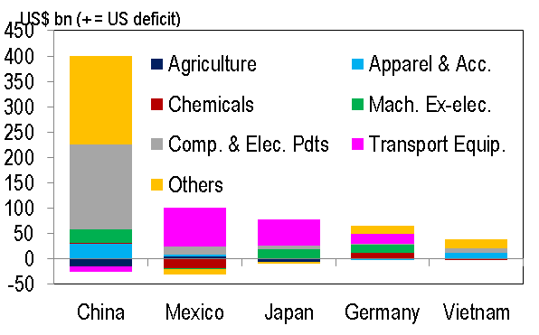
Exposure by Country
In a trade war scenario, it is global openness and trade exposure that is more relevant. Asia is more vulnerable to trade flow disruptions as its global supply chains are more integrated
Selected Countries – Exports to the US and Trade Balance with the US (% of GDP, Value Added terms), 2011
Selected Countries – Trade Openness (% of GDP, Value Added terms), 2011
Note: Exports and trade of goods and services. Source: Census Bureau and Citi Research
Note: Trade openness is defined as exports plus imports of goods and services. Source: OECD and Citi Research
Goods Trade Balance with the US, 2018 (USD bn)
Goods Trade Balance with US by Sector, 2017 (USD bn)
Source: Census Bureau and Citi Research
Source: Census Bureau and Citi Research

Slide 32
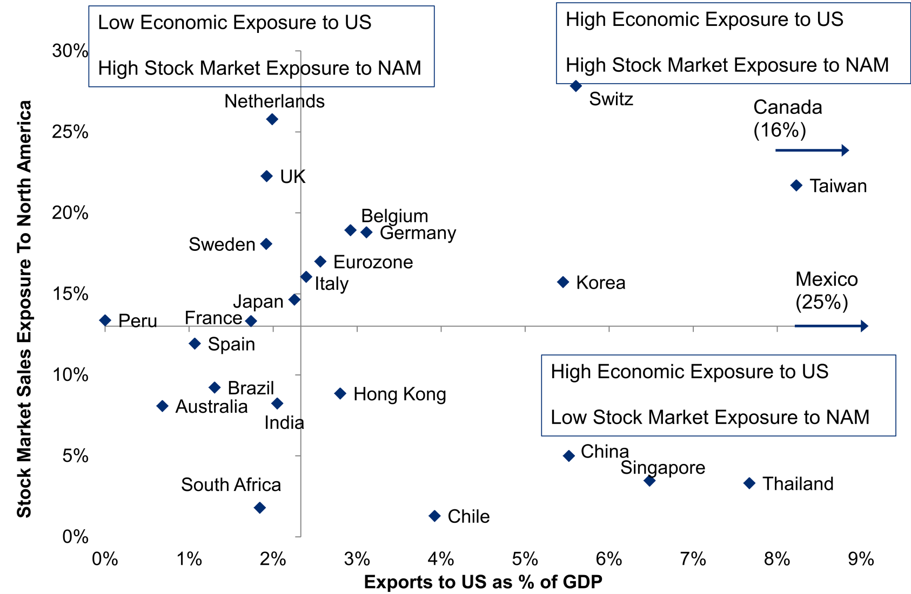
Stock Markets Exposure to the US Varies Across Economies…
The economies that are more vulnerable to protectionism through trade and its stock market include Mexico and Canada, but also Korea, Taiwan, and Switzerland.
Exports to the US (% of GDP) vs Stock Market Sales Exposure to North America
Note: North America sales exposure as reported by listed companies.
Source: Haver, Factset and Citi Research
See: Global Equity Strategist - Trade Wars: Equity Market Impact

Slide 33
As Good As It Gets
 | Global Growth: Still Strong, But No Longer Strengthening
 | Are We Running Out Of Room in This Cycle?
 | Monetary Policy Normalization Why is The Dollar Weakening? Are we heading for a Trade War? How resilient is India to likely shocks?

Slide 34
How resilient is India likely to be to AE interest rate and exchange rate shocks?
India an example of how an EM can be among most fragile or most resilient economies depending on domestic policy environment, prudential controls and macro imbalances.
India among fragile five when first sign of withdrawal/taper began in 2013, with INR plunging 27pc in 3months. That period for India was characterized by:
  High basic balance deficit (negative US$68bn or 3.7% GDP) with shortage of domestic savings to fund investments
  Negative real rates, dis-incentivizing domestic savings
  Policy paralyzed government at the center
Post-2013, as government and RBI took corrective action (with help of lower crude prices), some imbalances were corrected and INR among outperformers in Ems
  Basic balance turned surplus in FY15-FY17
  RBI shifted to formal flexible inflation targeting.
  Real rates rose to positive levels
  Strong mandate for reformist Modi government improved growth prospects
Recently:
  Rise in crude prices and more expansionary fiscal policy turned basic balance negative
  Political cycle turning/uncertainty rising some of the resilience could be tested.
  Capital controls help but not sufficient to insulate India from AE interest rate and exchange rate shocks

Slide 35
Conclusion
The Global Economy Looks Pretty Good – better than it has looked for a long time and probably as good as it is going to get in this cycle
We seem to get more asset price inflation than price inflation
Good times don’t last forever – imbalances are building, especially in the US, and resilience is diminishing
Plenty of shocks are also looming: India likely resilient but not immune.
Notes:
From the geos calendar, just bullets
-The S&P has gained approximately 15% this year
*Capitalized major words in the title

Slide 36
Citi Economic Forecasts Overview 2017F-2019F
 | GDP Growth |  |  | CPI Inflation |  |  | Central Bank Policy Rates
 | 2017F | 2018F | 2019F | 2017F | 2018F | 2019F | 2017 | 2018F | 2019F
Global | 3.3 | 3.4 | 3.4 | 2.4 | 2.5 | 2.4 | 2.5 | 2.6 | 2.8
Advanced Economies | 2.2 | 2.4 | 2.3 | 1.6 | 1.8 | 1.6 | 0.6 | 0.9 | 1.3
United States | 2.3 | 2.8 | 2.8 | 1.7 | 2.1 | 1.8 | 1.10 | 1.92 | 2.69
Japan | 1.7 | 1.3 | 1.2 | 0.5 | 1.0 | 0.9 | -0.10 | -0.10 | -0.10
Euro Area | 2.5 | 2.3 | 2.1 | 1.5 | 1.5 | 1.4 | 0.00 | 0.00 | 0.02
Canada | 3.0 | 2.0 | 2.1 | 1.6 | 2.5 | 1.8 | 0.75 | 1.44 | 2.31
Australia | 2.3 | 2.6 | 2.8 | 1.9 | 2.1 | 2.3 | 1.50 | 1.56 | 2.19
New Zealand | 2.7 | 3.0 | 3.2 | 1.9 | 2.0 | 2.3 | 1.75 | 1.75 | 2.06
Germany | 2.5 | 2.4 | 2.4 | 1.7 | 1.5 | 1.7
France | 2.0 | 2.2 | 2.3 | 1.2 | 1.6 | 1.3
Italy | 1.5 | 1.3 | 1.0 | 1.3 | 1.1 | 0.9
Spain | 3.0 | 2.8 | 2.3 | 2.0 | 1.4 | 1.4
Greece | 1.3 | 1.4 | 1.5 | 1.1 | 0.7 | 1.0
Ireland | 7.8 | 5.1 | 1.5 | 0.2 | 0.6 | 0.5
Portugal | 2.7 | 2.5 | 1.9 | 1.6 | 0.8 | 1.3
Sweden | 2.7 | 2.8 | 2.2 | 2.0 | 1.8 | 2.0 | 0.50 | 0.57 | 0.90
Switzerland | 1.1 | 2.1 | 2.2 | 0.5 | 1.0 | 0.9 | -0.50 | -0.49 | -0.18
United Kingdom | 1.8 | 1.6 | 1.6 | 2.7 | 2.6 | 2.0 | -0.75 | -0.75 | -0.63
Emerging Markets | 4.7 | 4.8 | 4.9 | 3.6 | 3.5 | 3.4 | 5.1 | 4.8 | 4.7
China | 6.9 | 6.7 | 6.4 | 1.6 | 2.1 | 2.1 | 3.31 | 3.53 | 3.60
India | 6.6 | 7.0 | 7.5 | 3.6 | 4.5 | 4.1 | 6.00 | 6.00 | 6.00
Russia | 1.5 | 2.3 | 2.5 | 3.7 | 2.7 | 3.7 | 9.04 | 7.08 | 6.63
South Africa | 1.3 | 2.0 | 2.2 | 5.3 | 4.9 | 5.3 | 6.88 | 6.54 | 6.50
Brazil | 1.0 | 2.4 | 2.5 | 3.5 | 3.2 | 3.9 | 9.83 | 6.40 | 7.38
Mexico | 2.0 | 2.3 | 1.9 | 6.0 | 4.5 | 4.1 | 6.67 | 7.48 | 7.19
Note: As of 18 April 2018. Aggregates at market exchange rates. Inflation aggregate with US PCE, CPI for the rest. Policy rates are annual averages. See: Global Economic Outlook and Strategy: April 2018
Source: National Statistical Offices and Citi Research

